Slide 1
VLSFO Viscosity and Pour Point:
Giving responders the information they need
Peter Taylor (Petronia) & Rob Cox (ISCO)

Slide 2
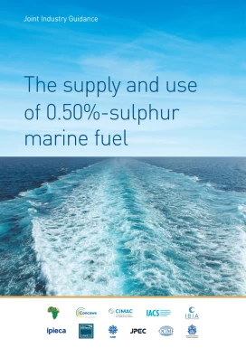
Jan 1, 2020: IMO mandates <0.5 m/m sulphur fuel (VLSFO) or Flue Gas Desulphurisation if using HFO
Industry produced guidance on compatibility and likely concerns
Variability in viscosity identified as a likely issue: predicted that the new fuels would have a lower viscosity and be more paraffinic, i.e. prone to the formation of wax residues in cold temperatures, depending on the pour point
This Joint Industry Guidance recommended a fuel supplier provide inter alia the following to the ship:
viscosity;
density;
cold flow properties such as pour point and cold filter plugging point (CFPP) as applicable to the grade of fuel;
any other information that the supplier considers operationally useful for the ship to know;
Implicitly assumed that the best place for this would be the physical BDN, however this has not happened for Pour Point – possibly the most important parameter - or viscosity

Slide 3
Operational experience
There is an accepted body of evidence on the variability of VLSFO composition.
This has significant implications for oil spill preparedness. The fate and behaviour of spilled VLSFOs will vary widely, depending on their composition and ambient environmental conditions, including sea temperatures.
Any general guidance on response options for VLSFOs is of limited use. Responders need specific information about a spilled oil for effective decision making.
In addition to informal discussions with ITOPF, on their experience with the MV WAKASHIO (Mauritius), AM GHENT (Gibraltar), EXPRESS PEARL (Sri Lanka), FELICITY ACE (Azores) and other incidents we have anecdotally reviewed the following with a view to the properties of VLSFO as they inform clean up and recovery strategies:
IMAROS I (EU/Norway) study
Interspill June 2022 presentation Session 6 (Chever, Le Masurier et al)
ISO/PAS 23363 & ISO 8217 specifications including ISO 8217:2024*
SINTEF & CEDRE Studies
CONCAWE/Fuels Europe/ISO studies
MEPC 78/14/1 (Iceland and Norway)
2024 fuel quality report (BV Verifuel)
*ISO 8217:2024 introduced a minimum viscosity spec

Slide 4
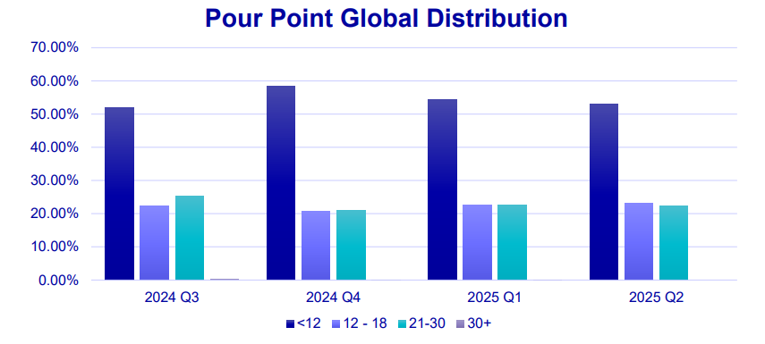
Variations in VLSFO Pour Point (BV 2024 Annual Report)
<12°C
12-20 °C
21-30 °C
>30 °C

Slide 5
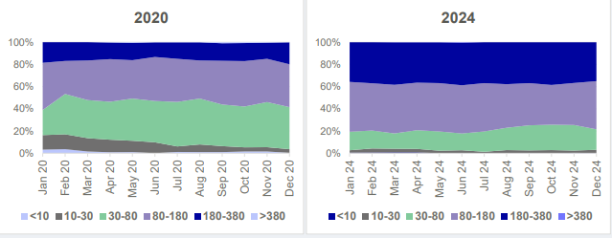
Variations in Viscosity (BV 2024 Annual Report)
Viscosity has increased since VLSFO introduction in 2020, but can still fluctuate substantially between delivery locations
Higher viscosity
Viscosity in centistokes @ 50°C
Introduction of ISO 8217:2024 minimum Viscosity requirements has meant many (most?) VLSFOs will fail on Viscosity

Slide 6
Move to e-BDN (Bunker Delivery Note – required under MARPOL Annex VI)
Singapore, the world’s largest bunkering port, now fully transitioned to digital bunkering.
From April 1, 2025, all bunker suppliers in Singapore required to provide digital services and issue electronic-BDNs as the default –and in theory will facilitate the addition of additional parameters (e.g. Viscosity and Pour Point) useful to responders
Singapore worked with IMO to authorise this, and it appears that Viscosity is now included, in Singapore at least
Question remains: can we rely on what is stated in the BDN? Typically, the BDN is made basis the Certificate of Quality from the loading of the terminal/barge. The analysis could’ve been made some weeks before the actual bunkering and it is possible that the fuel quality has changed during this time, possibly due to mixing with other products in the barge.

Slide 7
The Challenge:
How to ensure that our community can access oil characteristics i.e. “know the oil”, in both planning and response contexts?
Could mandating pour point on the BDN be a step forward?
Thank You

